Slide 1


  lesson 2
  The Shapes of Computers Today

Slide 2
This lesson includes the following sections:
    Supercomputers
    Mainframe Computers
    Minicomputers
    Workstations
    Microcomputers, or Personal Computers

Slide 3
The Shapes of Computers Today
- Supercomputers
  Supercomputers are the most powerful computers. They are used for problems requiring complex calculations.
  Because of their size and expense, supercomputers are relatively rare.
  Supercomputers are used by universities, government agencies, and large businesses.

Slide 4
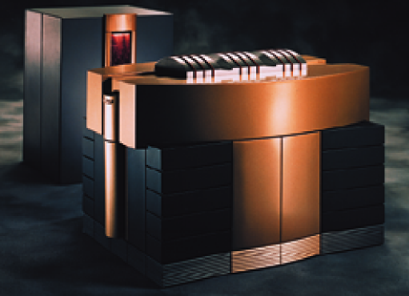
Cray T90 Supercomputer

Slide 5
The Shapes of Computers Today
- Mainframe Computers
Mainframe computers can support hundreds or thousands of users, handling massive amounts of input, output, and storage.
Mainframe computers are used in large organizations where many users need access to shared data and programs.
Mainframes are also used as e-commerce servers, handling transactions over the Internet.

Slide 6
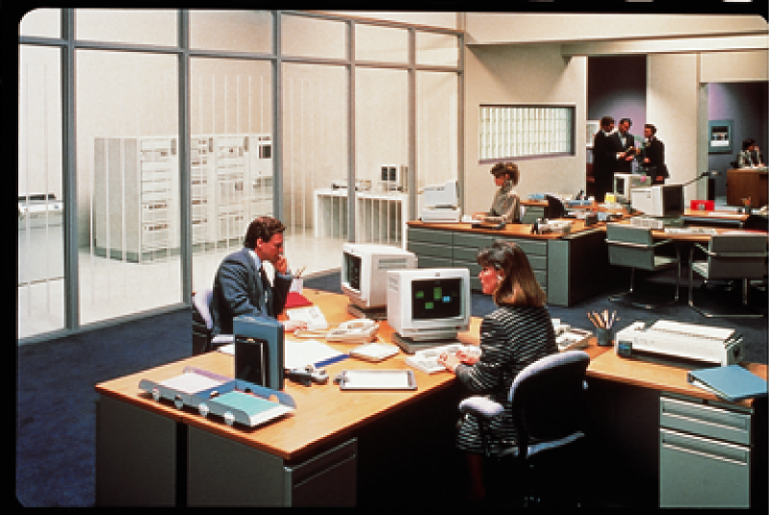

Slide 7
The Shapes of Computers Today
- Minicomputers
Minicomputers are smaller than mainframes but larger than microcomputers.
Minicomputers usually have multiple terminals.
Minicomputers may be used as network servers and Internet servers.

Slide 8
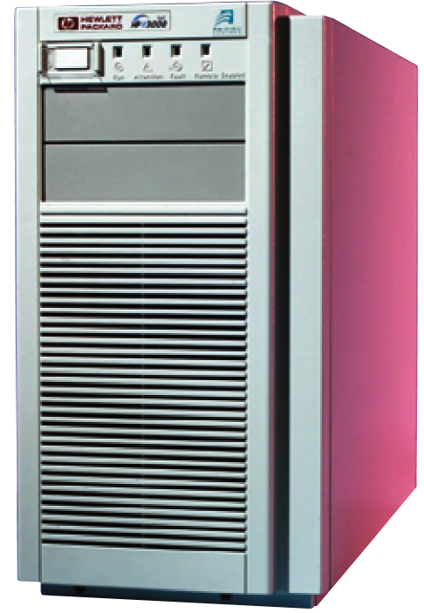
Minicomputer

Slide 9
The Shapes of Computers Today –
Workstations
Workstations are powerful single-user computers.
Workstations are used for tasks that require a great deal of number-crunching power, such as product design and computer animation.
Workstations are often used as network and Internet servers.

Slide 10
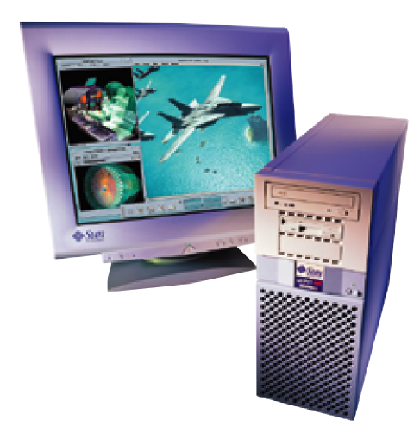
Sun Workstation

Slide 11
The Shapes of Computers Today –
Microcomputers, or Personal Computers
Microcomputers are more commonly known as personal computers. The term "PC" is applied to IBM-PCs or compatible computers.
Full-size desktop computers are the most common type of PC.
Notebook (laptop) computers are used by people who need the power of a desktop system, but also portability.
Handheld PCs (such as PDAs) lack the power of a desktop or notebook PC, but offer features for users who need limited functions and small size.

Slide 12
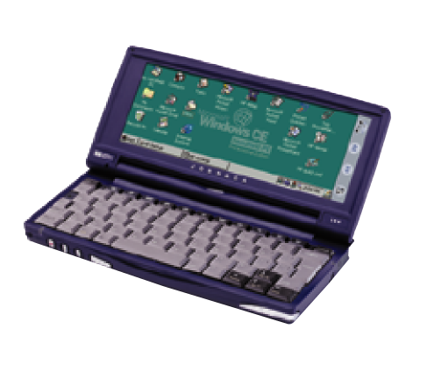
Handheld PC
Philips Velo

Slide 13
lesson 2 Review
List the five most common types of computer systems.
Identify two unique features of supercomputers.
Describe a typical use for mainframe computers
Differentiate workstations from personal computers.
Identify four types of personal computers.

